Slide 1


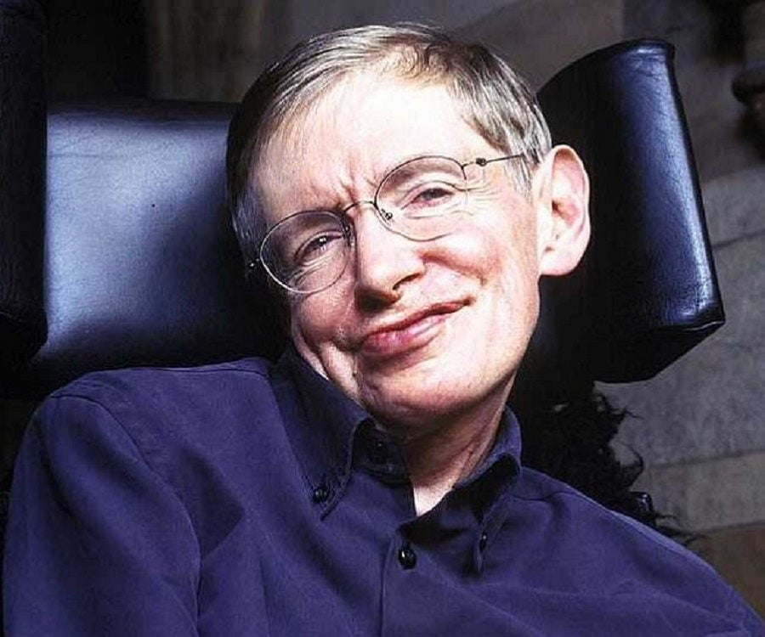
Stephen Hawking: a Modern Darwin?
HaiTian Wu
BIOL 0190P
Fall 2023
This Photo by Unknown Author is licensed under CC BY-NC-ND

Slide 2
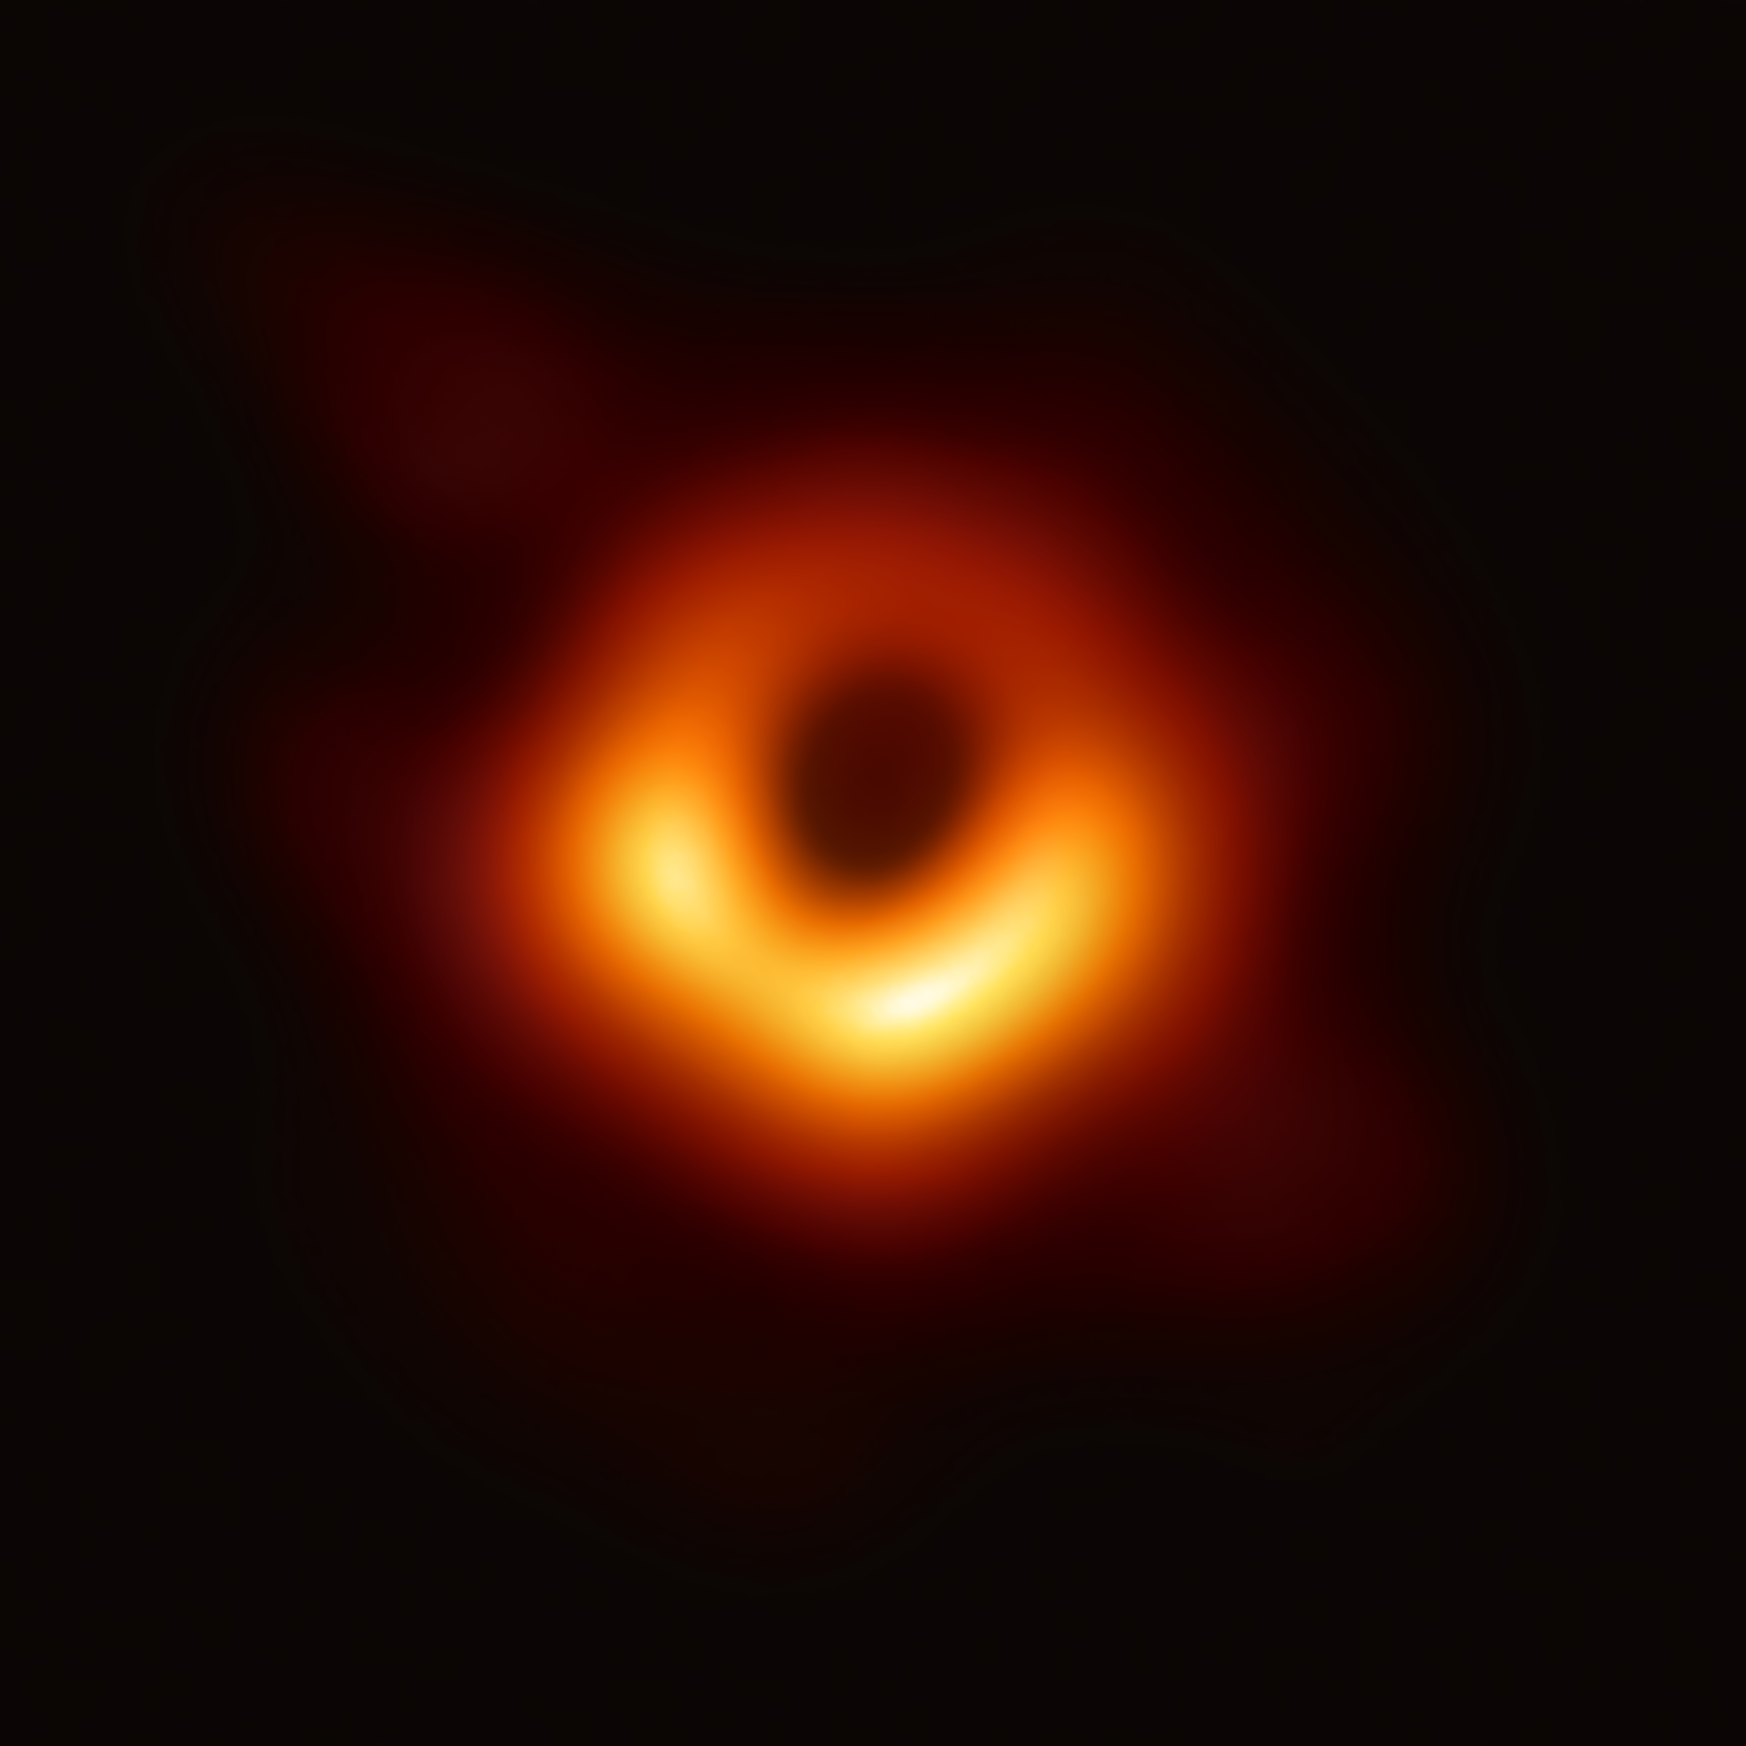
Who was Stephen Hawking?
Stephen Hawking was a British theoretical physicist and cosmologist as well as an author
His scientific contributions include investigating the origin of the universe and major advancements in the theory of black holes, including Hawking radiation
He was also the author of various popular science books, such as “A Brief History of Time”
This Photo by Unknown Author is licensed under CC BY-SA

Slide 3

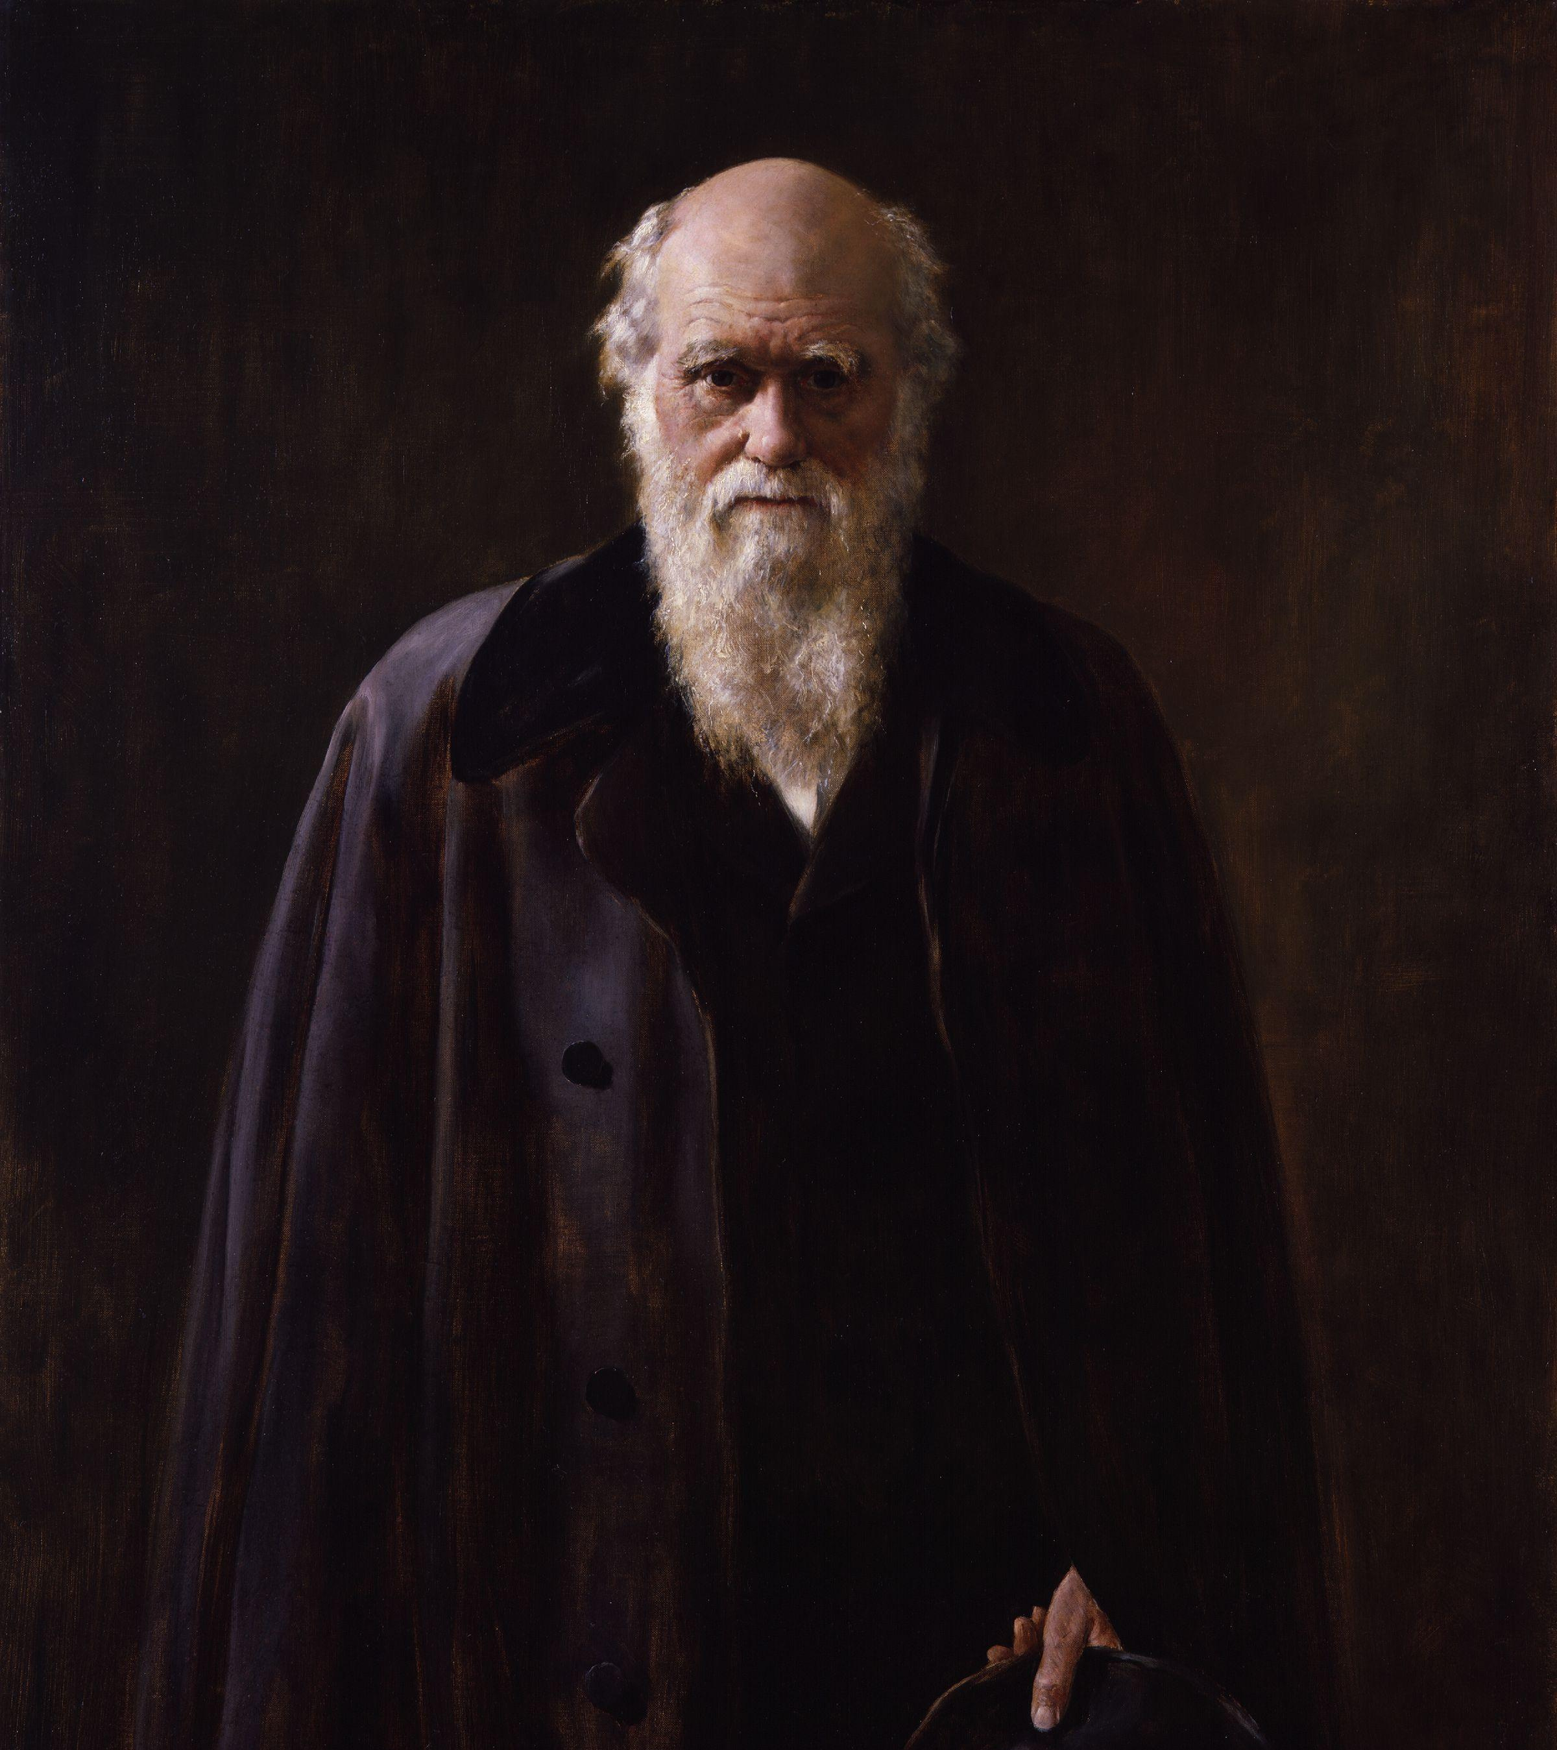
Comparison to Darwin
How was Stephen Hawking similar to Charles Darwin?
This Photo by Unknown Author is licensed under CC BY-SA

Slide 4
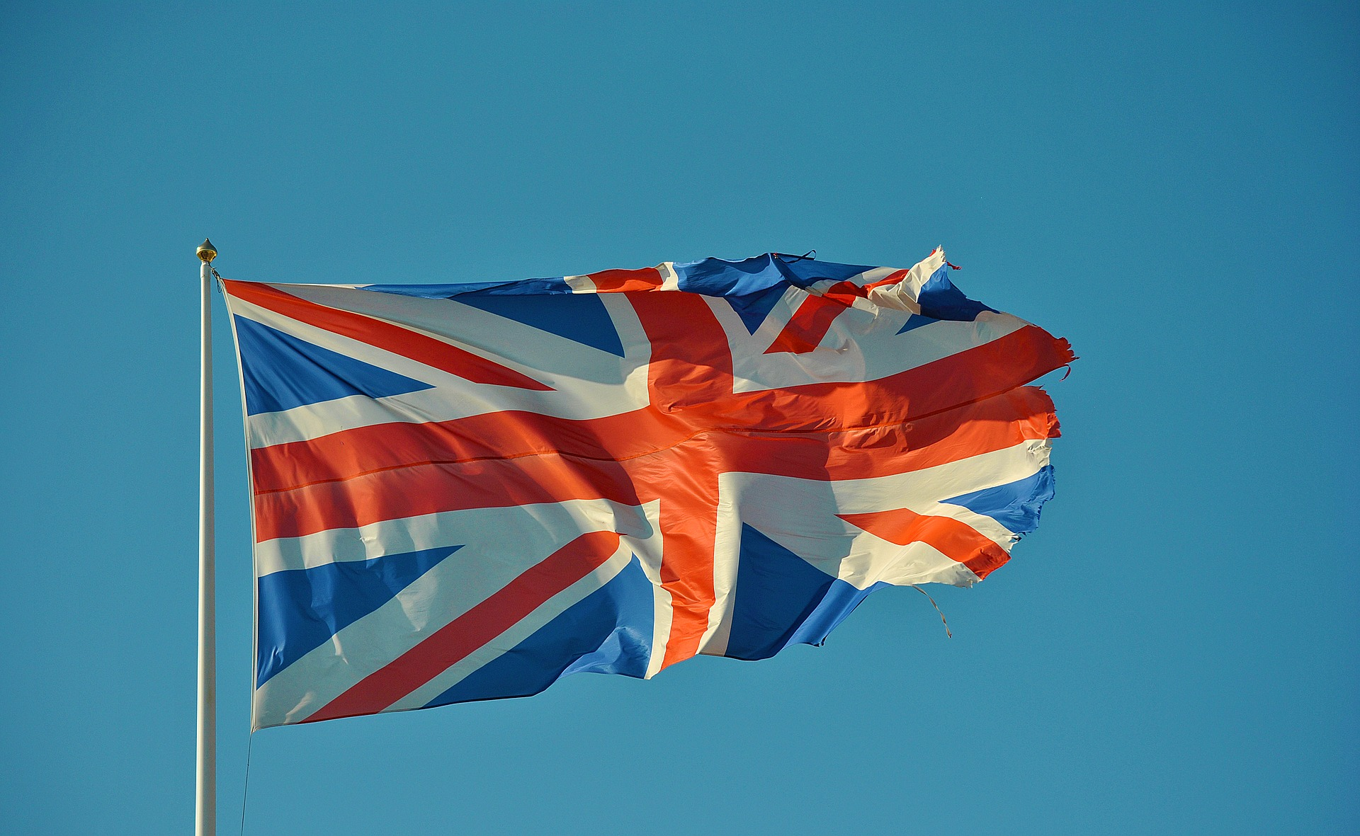
Early Life
This Photo by Unknown Author is licensed under CC BY-NC-ND
Hawking
Darwin
Born in 1942 in Oxford, England
Eldest of 4 children
Father: Dr. Frank Hawking, Oxford graduate and medical researcher
Mother: Isobel Hawking, Oxford graduate
Found wonder at the sky and universe
Did not appear exceptional in school before college
Born in 1809 in Shrewsbury, England
Second son, 5 siblings
Father was a physician trained at Edinburgh University
Dabbled in chemistry as a child
Did not enjoy learning classics at the Anglican Shrewsbury School

Slide 5
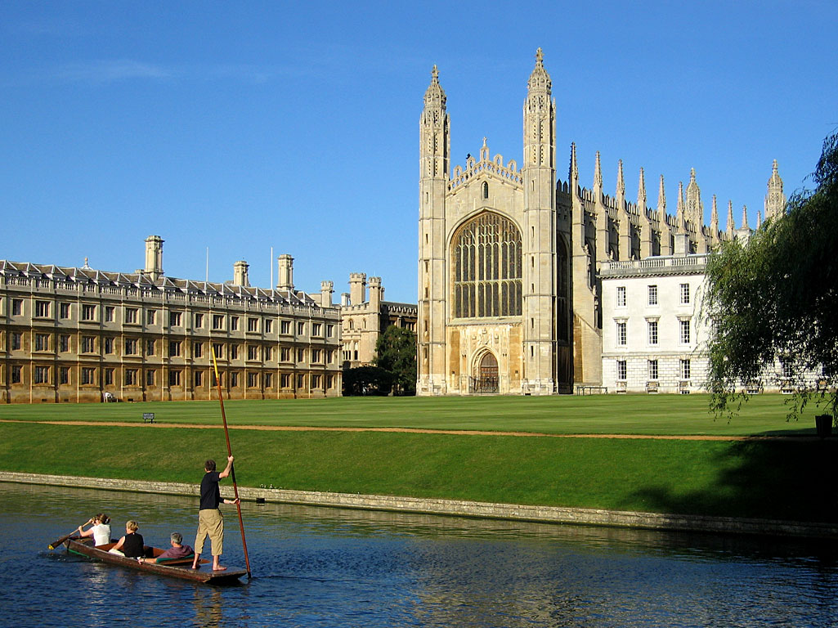
Education
Both studied at Cambridge:
Darwin switched to Christ’s College in Cambridge from studying medicine at Edinburgh, earning a Bachelor of Art’s degree
Hawking studied physics (natural sciences) and University College, Oxford, earning first class degree
Hawking then went to Trinity Hall at Cambridge University to earn a Ph.D. in cosmology
Neither dedicated too much time to their studies in college:
Hawking averaged 1 hour per day of school-related studies at Oxford, but he was still successful at his exams
This Photo by Unknown Author is licensed under CC BY-SA

Slide 6
Intellectual Influences
Darwin was influenced by various mentors/figures:
Grant at Edinburgh – invertebrates and origins of creatures
Henslow at Cambridge – botany
Sedgewick at Cambridge – geology
Lyell – geography
Malthus – competition
HMS Beagle – while not a person, Darwin’s experiences traveling enormously influenced his ideas on geography and species
Hawking:
Doctoral training at Cambridge under cosmologist Dennis Sciama
Roger Penrose – met at Cambridge, singularities, Einstein’s general relativity
Remained at Cambridge as a research fellow

Slide 7
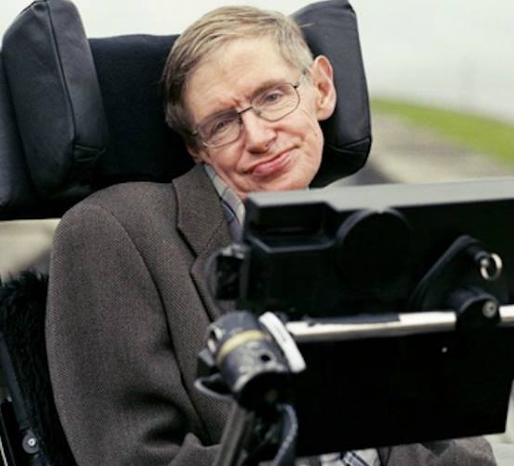
Health
Both Darwin and Hawking struggled with physics health:
Darwin had a mysterious illness that severely limited his ability to work
Hawking was diagnosed with amyotrophic lateral sclerosis (ALS) at age 21. He was not expected to survive past another 2 years. He did survive, but he would later be confined to a wheelchair and lost his voice.
Hawking’s diseases motivated him to dedicate himself to his work
This Photo by Unknown Author is licensed under CC BY-SA

Slide 8
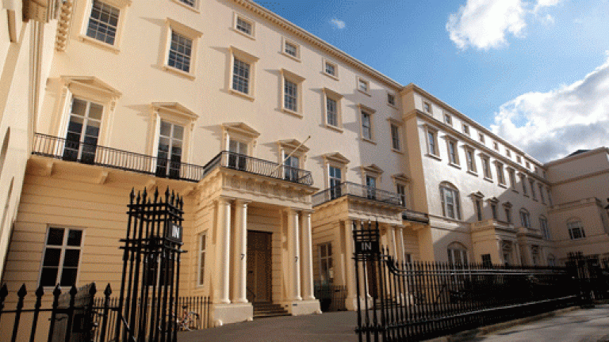
Recognition, Awards, and Honors
Darwin: Royal Medal (1852, for barnacles), Copley Medal (1864), Royal Society Fellow
“On the Origin of Species”: Natural selection, mixed reception
Mostly a private figure
Hawking: Lucasian Professor of Mathematics at Cambridge, Royal Society Fellow, Copley Medal (2006), Presidential Medal of Freedom (2009), Commander of the British Empire (1982), …
“Black Hole Explosions?”: Nature publication over Hawking radiation, initially controversial and disputed, unifies general relativity with quantum theory
No Boundary Proposal: Big bang and early universe
“A Brief History of Time”: Best-selling book aimed at public audiences
Had a huge public appearance
This Photo by Unknown Author is licensed under CC BY

Slide 9

Religion and Philosophy
Darwin: claimed to be agnostic, loss of faith in Christianity
Hawking: Did not believe in the necessity of God in creating the universe, atheist.
Both believed in the laws of science rather than a reliance on God to explain phenomena
“We could call order by the name of God, but it would be an impersonal God.” (Hawking)
Search for understanding/origins:
“My goal is simple. It is a complete understanding of the universe, why it is as it is and why it exists at all.” (Hawking)

Slide 10
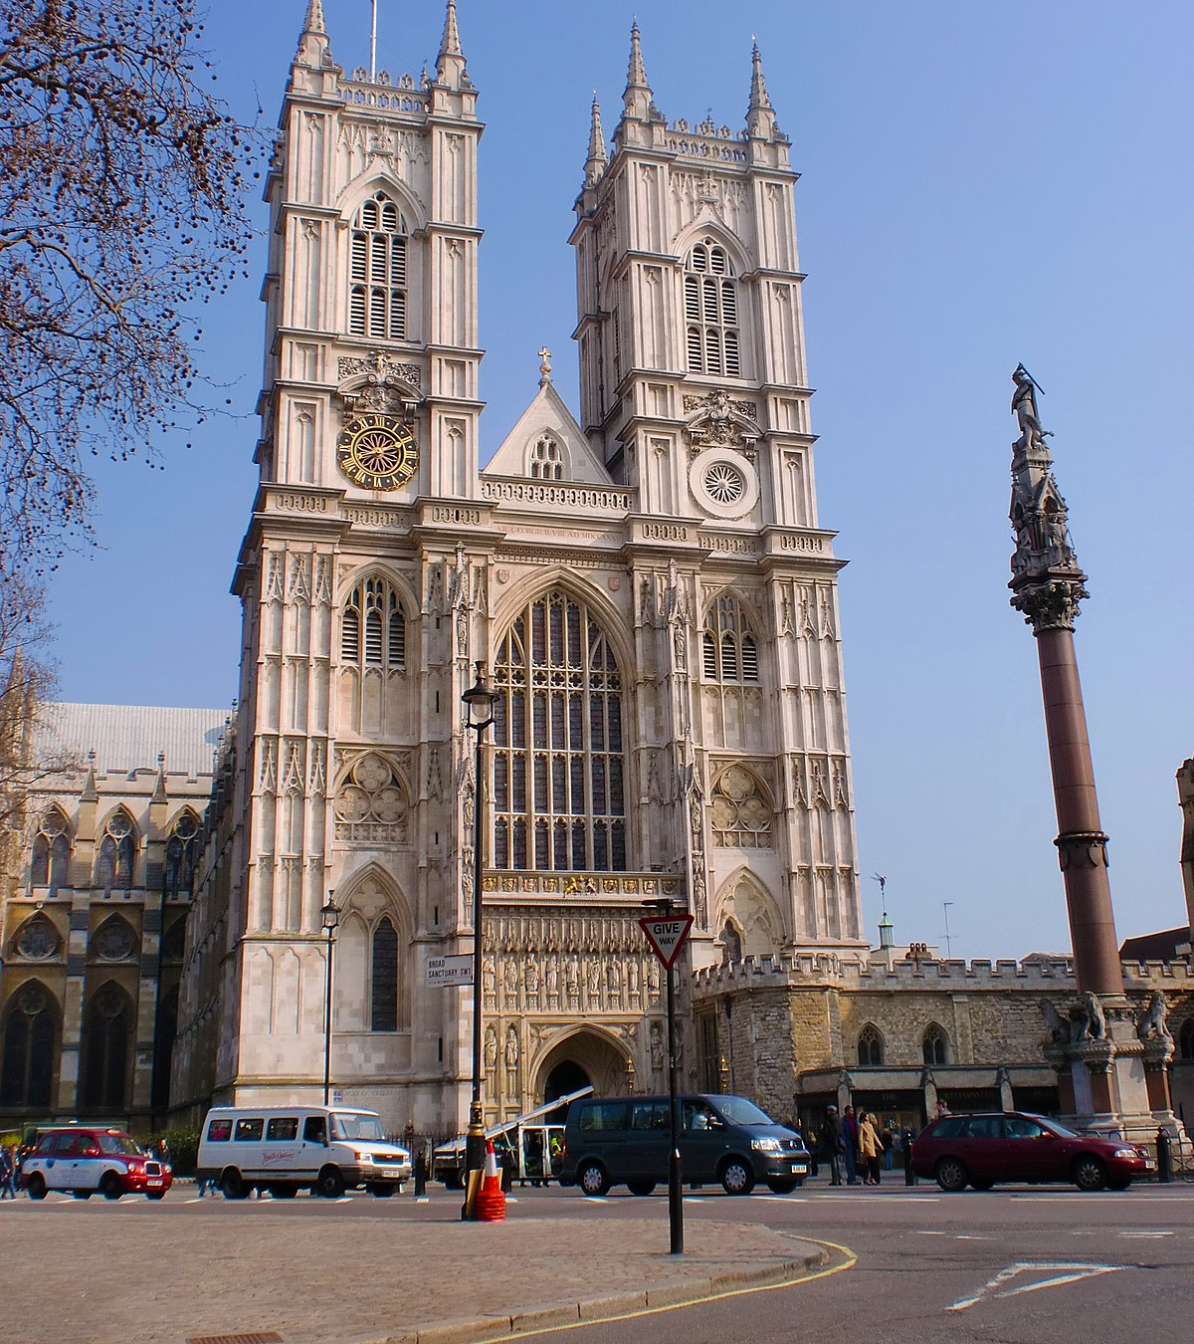
Death and Burial
Hawking died at 76 due to ALS at his home in Cambridge.
He is buried in Westminster Abbey, next to scientific giants such as Sir Isaac Newton and Charles Darwin.
This Photo by Unknown Author is licensed under CC BY-SA

Slide 11
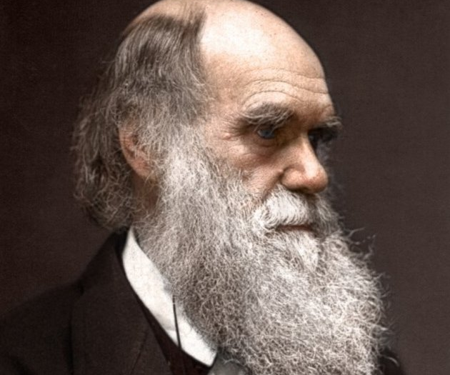
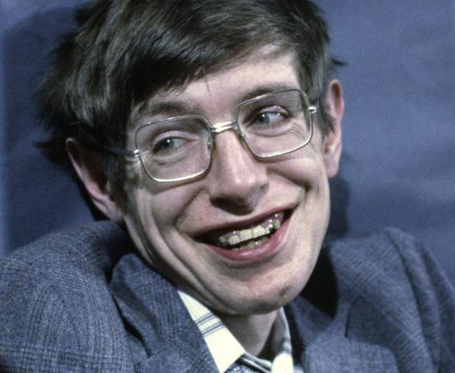
Key Takeaways
Both Darwin and Hawking where monumental figures in their fields and on society in general, though in different ways
Both were driven in their work for a desire for understanding, but with different approaches
Both were willing to ask questions and challenge conventional ideas
Both were very involved with other prominent scientific figures in their fields
Both had similar aspects in their perspectives on religion
This Photo by Unknown Author is licensed under CC BY-SA
This Photo by Unknown Author is licensed under CC BY

Slide 12
References
https://www.biography.com/scientists/stephen-hawking
https://www.space.com/15923-stephen-hawking.html
https://www.hawking.org.uk/biography
https://www.iop.org/physics-community/obituaries/stephen-hawking#gref
https://www.britannica.com/biography/Charles-Darwin
https://iep.utm.edu/darwin/

